Slide 1
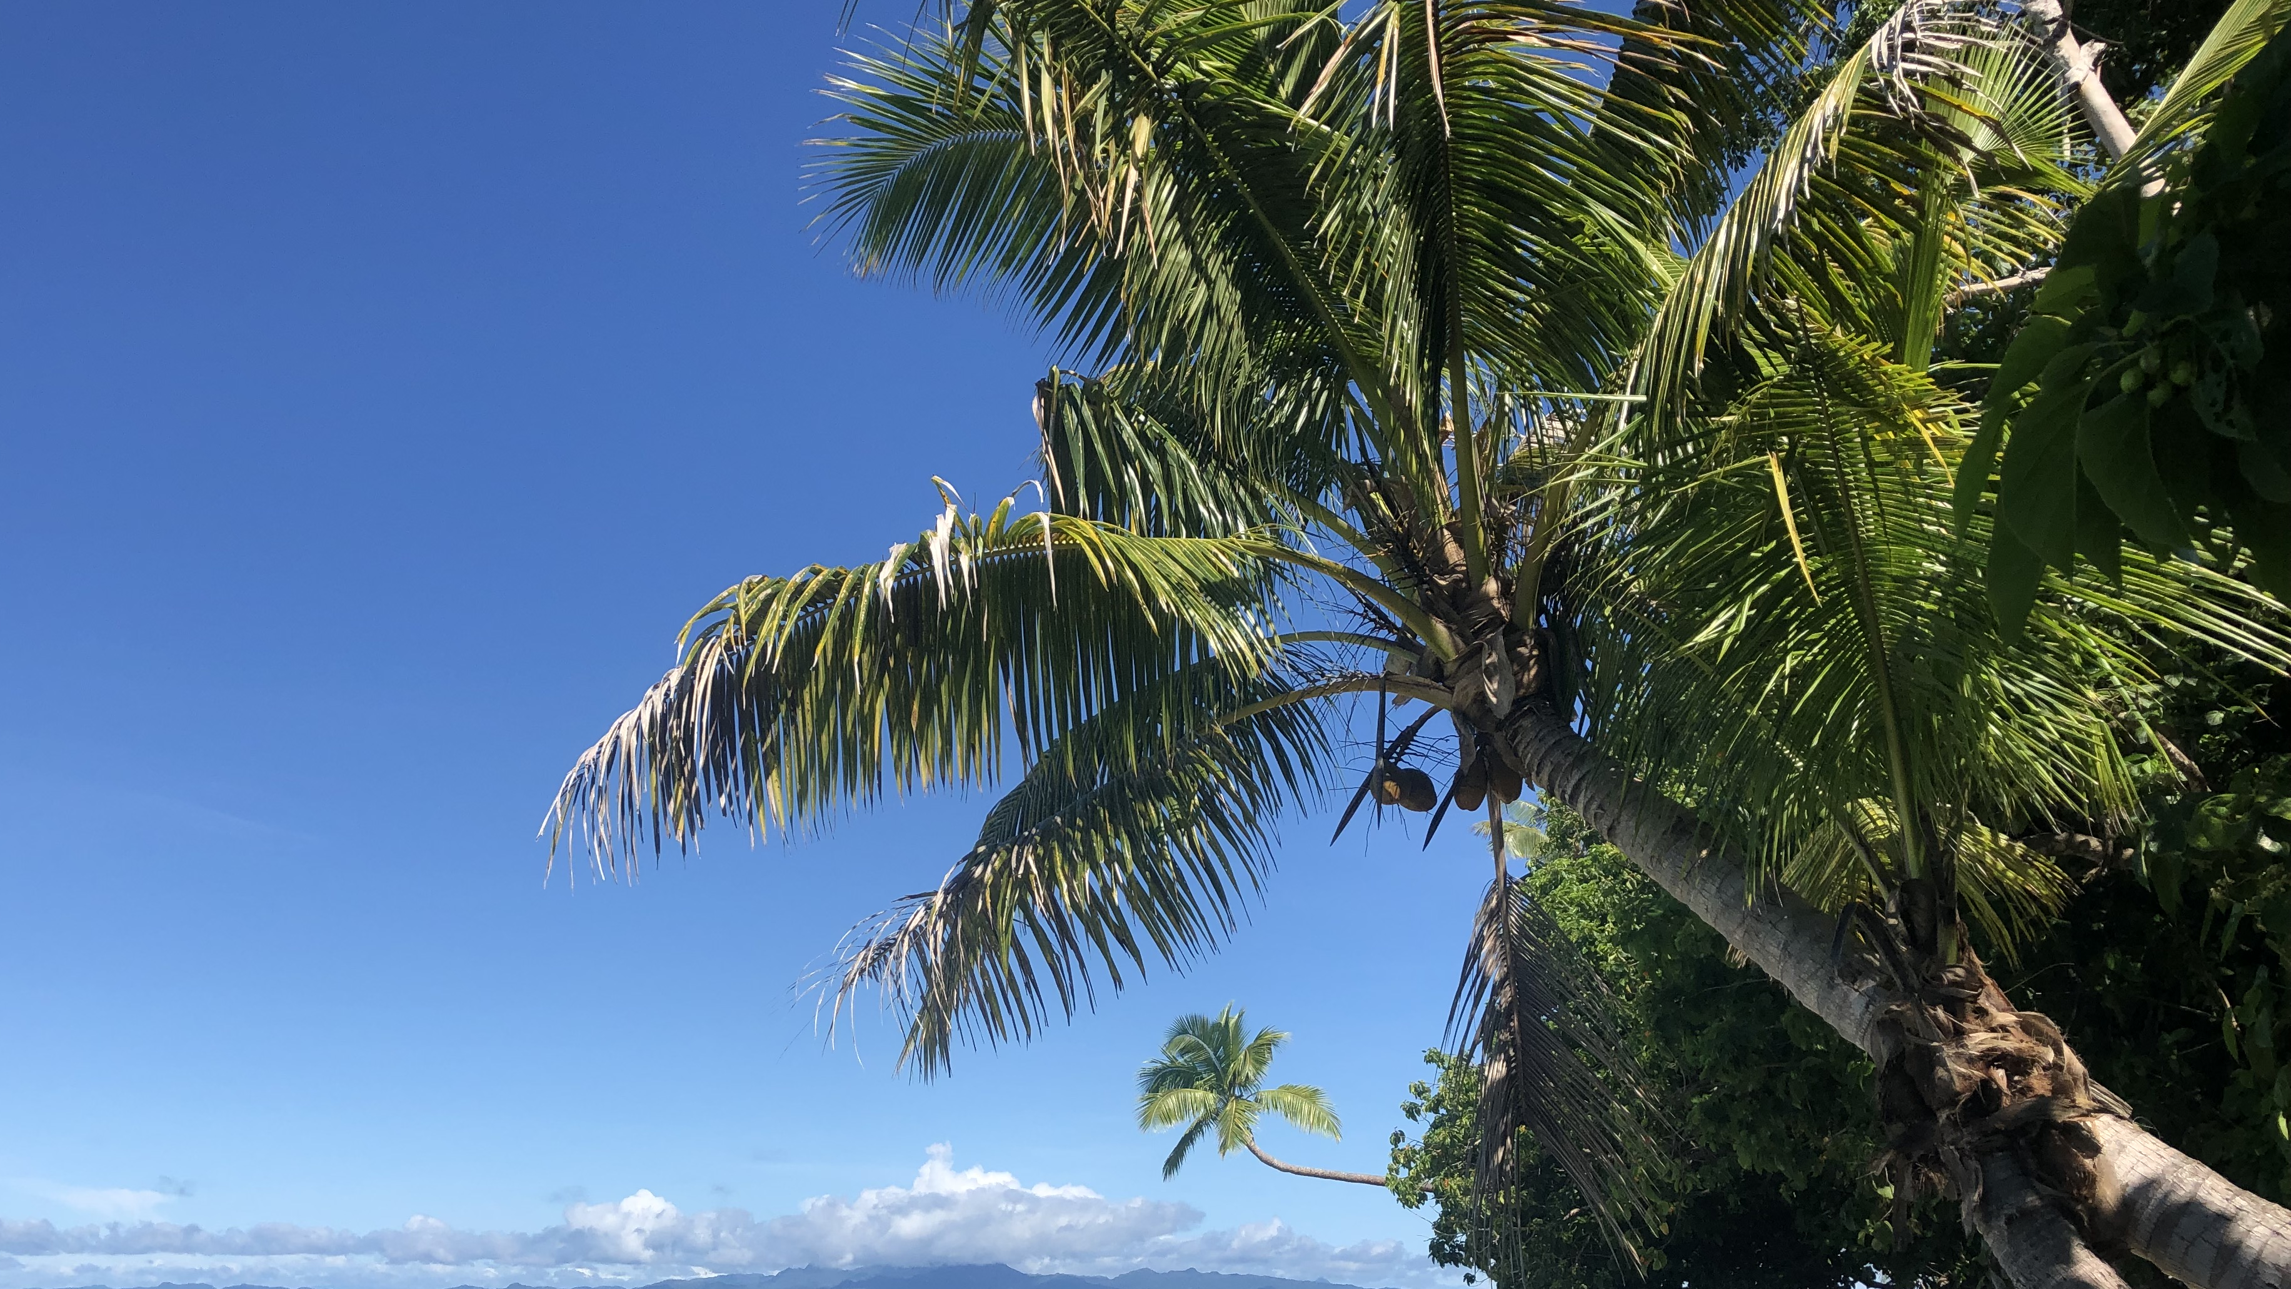
OCN 479-001
Electronics 101

Slide 2
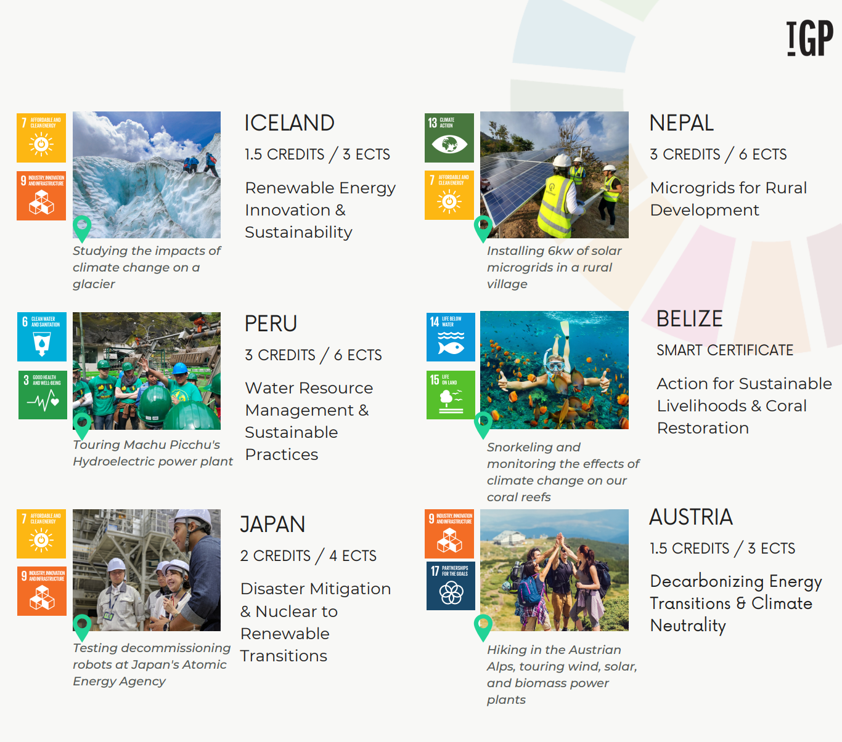

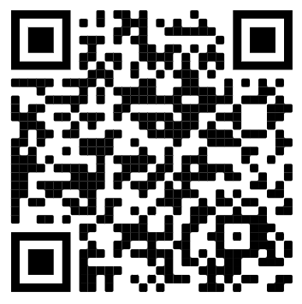
Short-term (8-10 days),
hands-on study abroad trips
focused on sustainability
Apply today
to start your TGP journey!
↵
UNCW Ambassador: Shelby Diehl | Contact: svd3491@uncw.edu | Connect: www.linkedin.com/in/shelby-diehl/

Slide 3


Slide 4
Today’s plan
Lecture
Pick up where you left off with GitHub intro and
Complete second lab activity (building off first)

Slide 5
Homework (due Sep. 22) Everyone—not just 1 per group
Canvas Assignment:
Send me link to your completed repository for the Intro to GitHub exercise from last week
Send me the link to your group’s SOS code repository—see guidelines on next slide
Canvas Discussion:
Post on Canvas Discussion thread on two projects of interest based on materials on class GitHub repo; we’ll use these to form teams

Slide 6
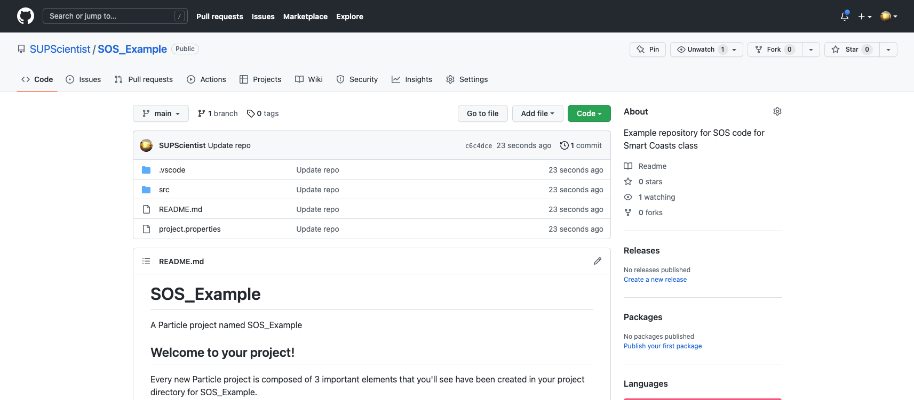
SOS code repository must look like close to this for credit:

Slide 7
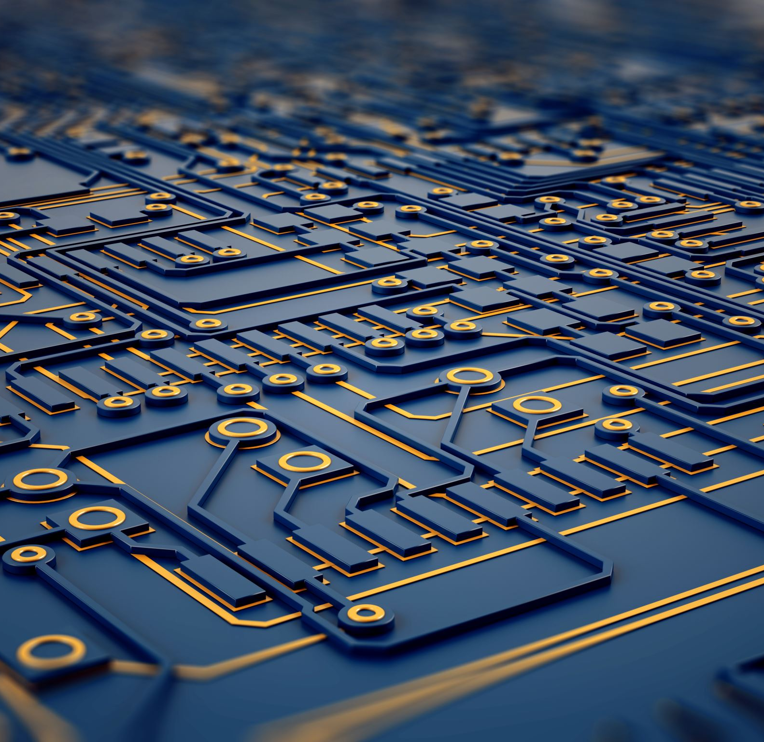
Today’s topics
Working with Electronics 101

Slide 8
Electronics 101
Ohm’s Law: V = IR
Watch https://www.khanacademy.org/science/physics/circuits-topic/circuits-resistance/v/circuits-part-1 for more if additional background needed
Building circuits
Breadboarding circuits
Soldering wires and components
Key electrical components
Power supply (battery)
Resistors
Capacitors
LEDs (often soldered onto boards, sometimes built separately into circuits)
Transistors: one of the most important inventions of the 20th century (Time Magazine)

Slide 9

Next up:
Background and how-to videos

Slide 10
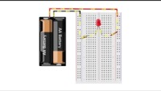
Part 1: How to use a breadboard

Slide 11
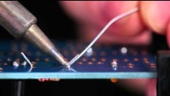
Part 2: Soldering

Slide 12
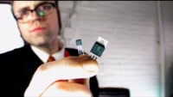
Part 3: Transistors (and way too much bass—sorry)

Slide 13
Today’s lab
Finish last week’s if you haven’t
Send me links as described in assignment post on Canvas
Find GitHub repo for Eidam et al. paper
Sketch basic circuitry for Eidam et al. design
Find components for Eidam et al. design and breadboard

